Slide 1


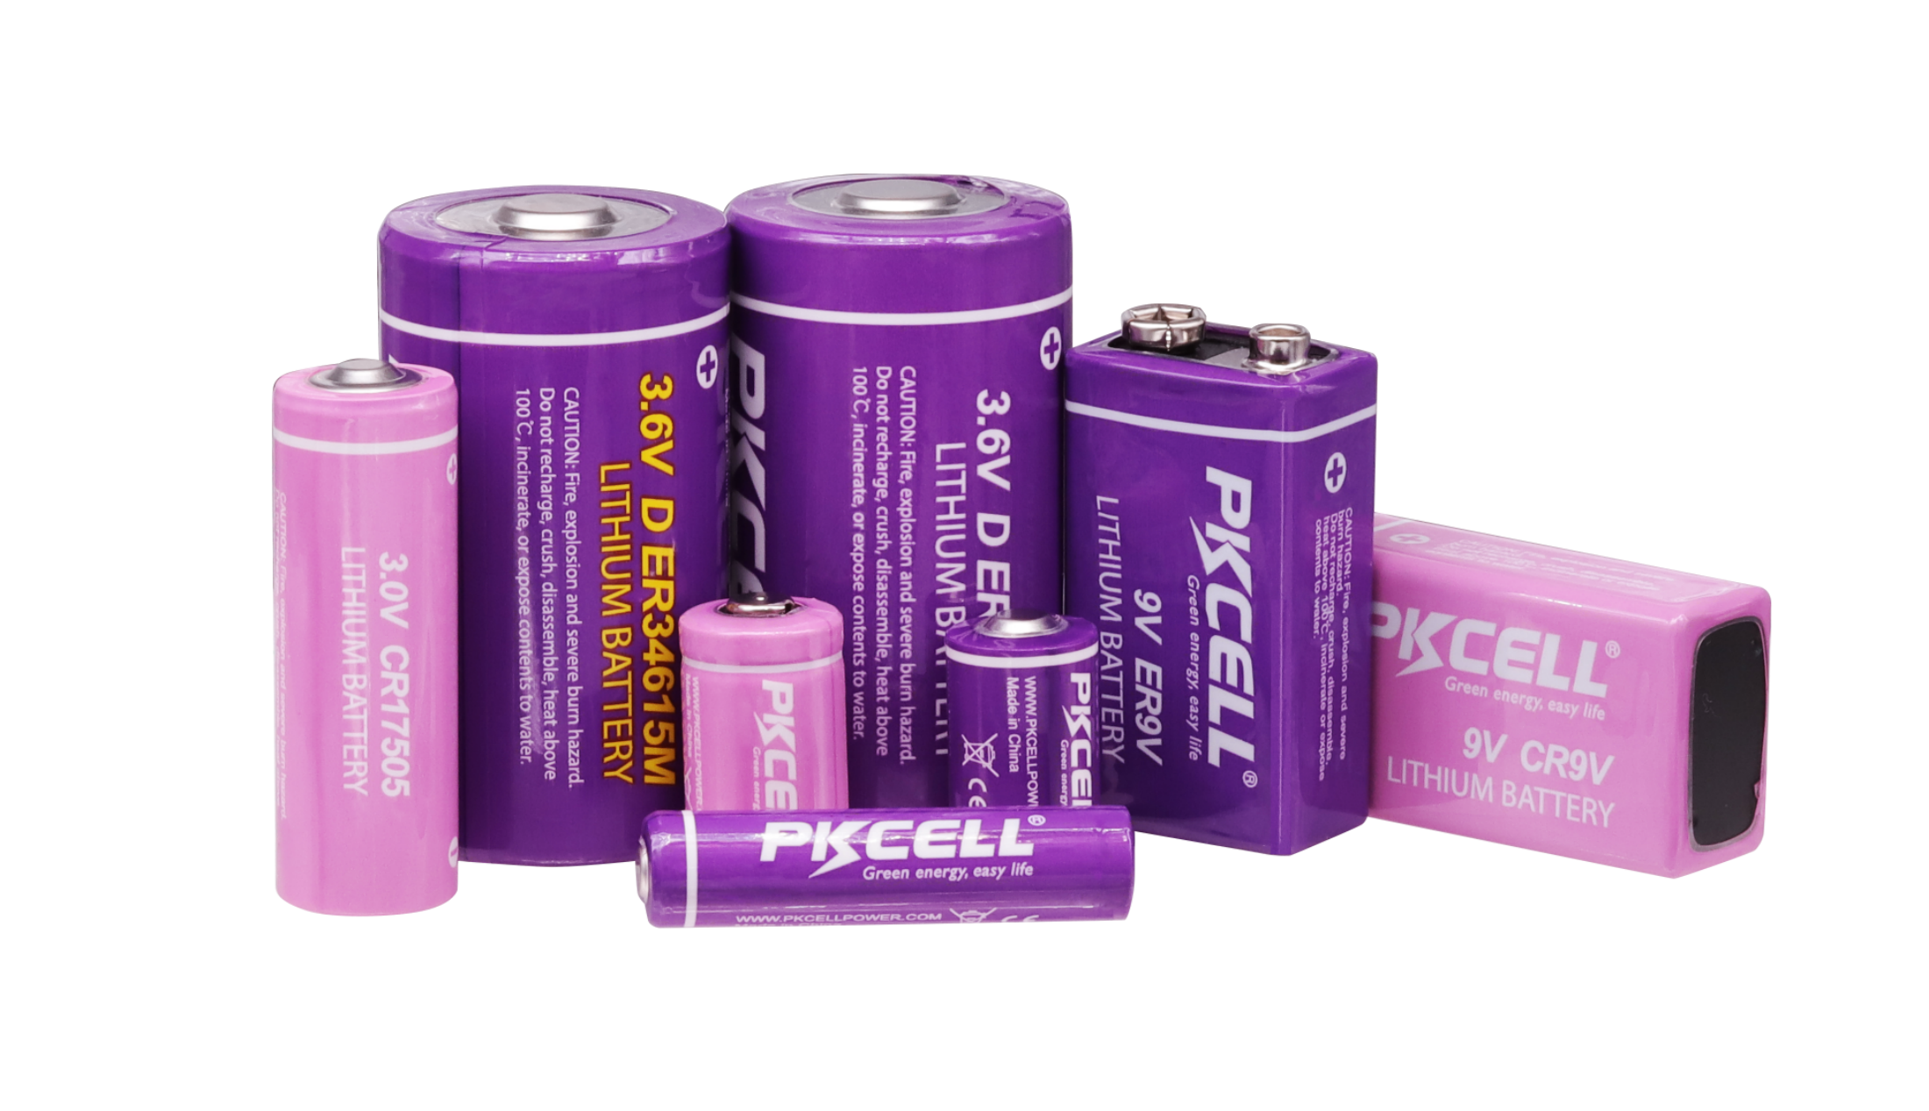
www.pkcellpower.com
Shenzhen PKCELL Battery CO., LTD

Slide 2
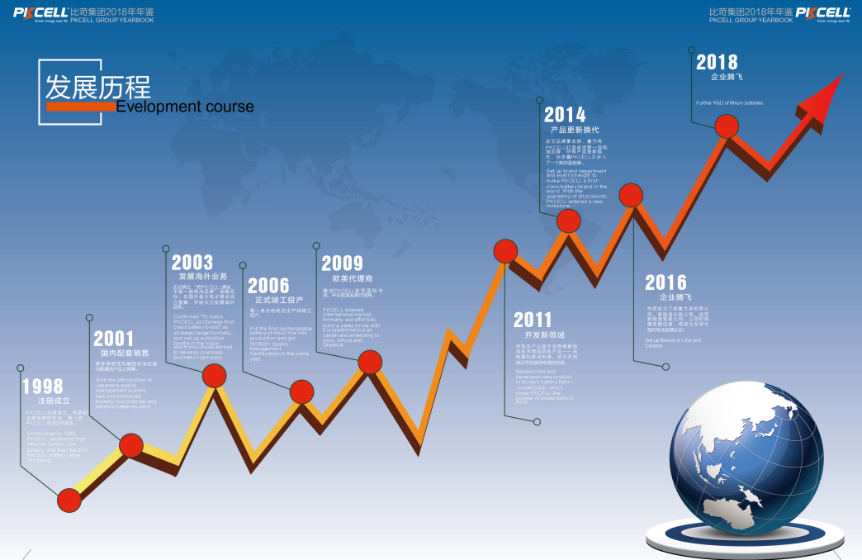

Slide 3
CONTENTS
1.
Introduction
4.
Facility & Certification
2.
Why Choose Us
5.
Partners
3.
Products
6.
Production Lines

Slide 4
Introduction
1.
5.

Slide 5
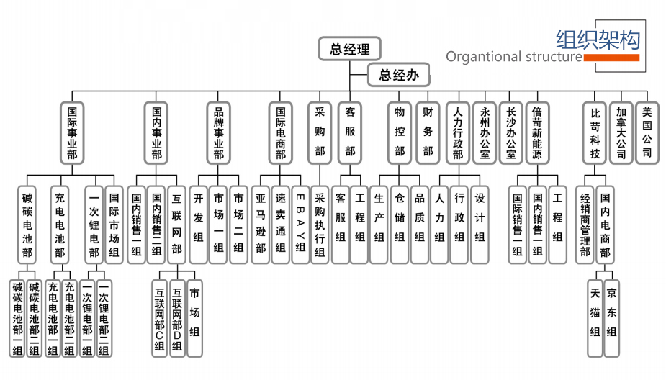

Slide 6
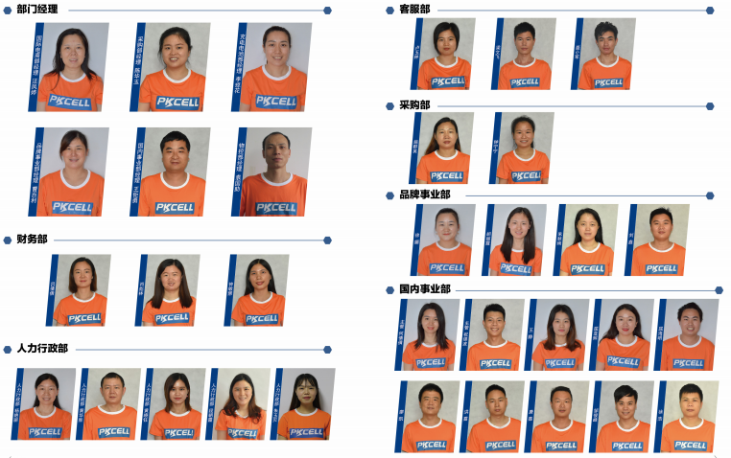
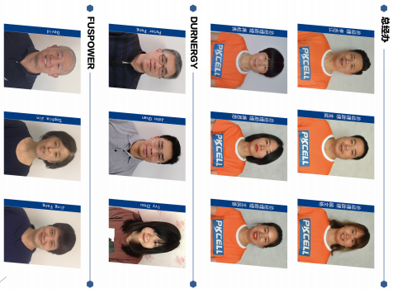
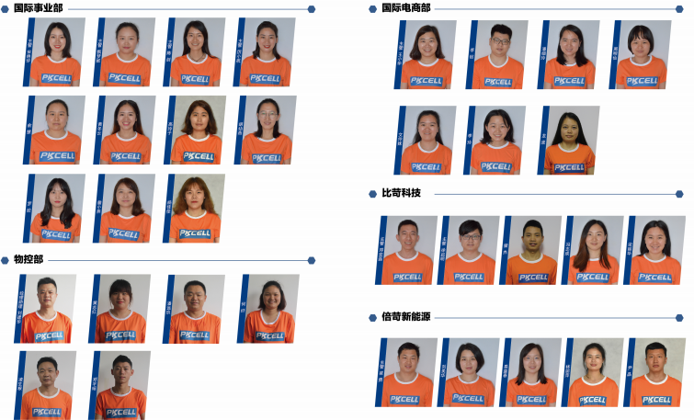
PKCELL
MANAGEMENT

Slide 7
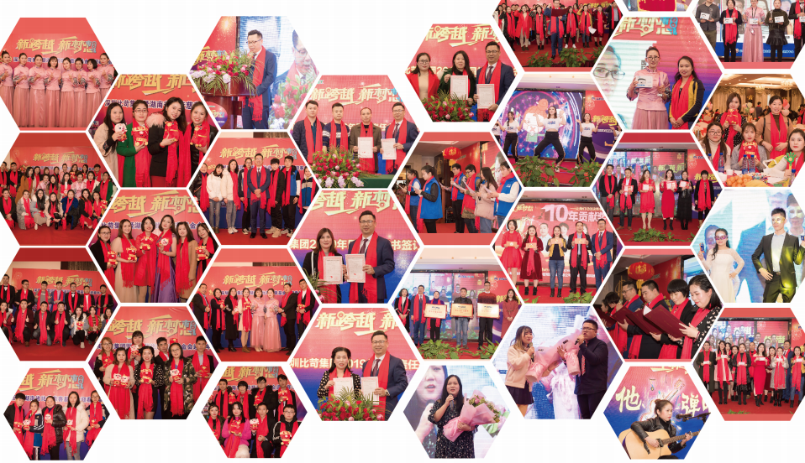
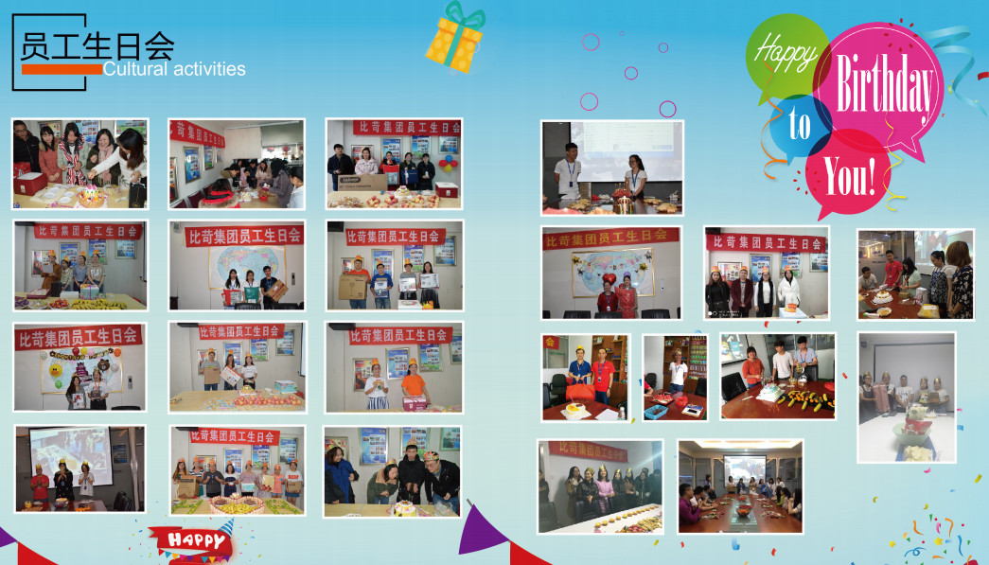
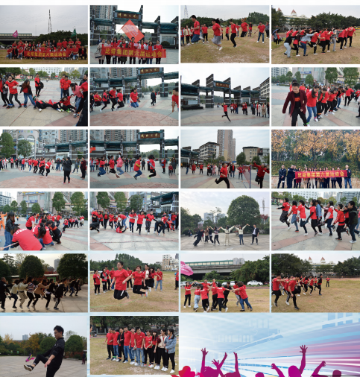
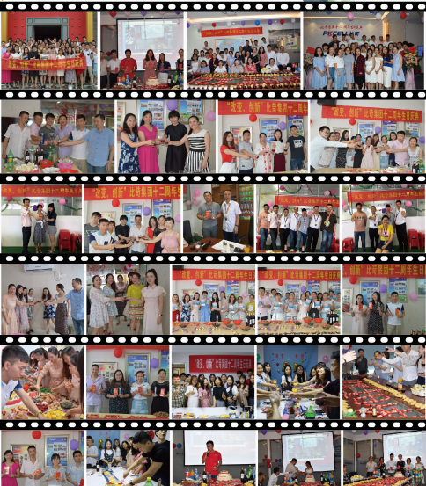
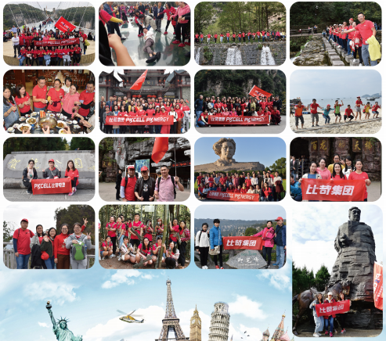
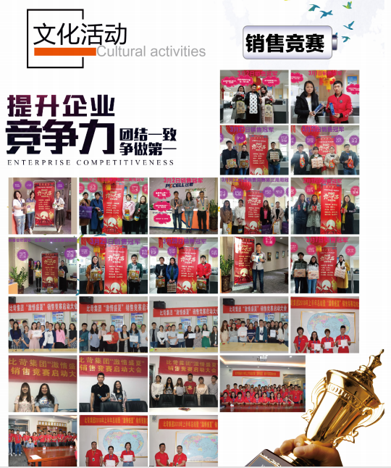
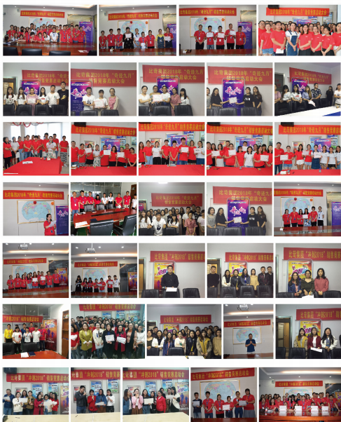
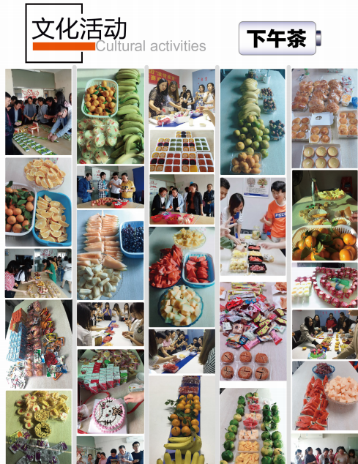
Life in PKCELL

Slide 8
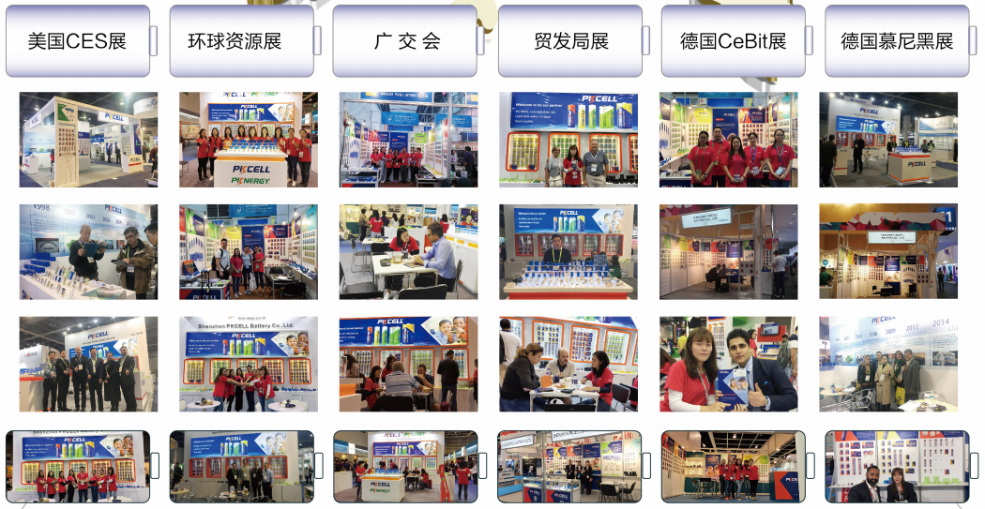

Slide 9

Development
PKCELL Group
Yongzhou
(Branch)
Durengy in CA
(sub company)
Fuspower in US
(sub company)
Changsha
(Branch)
Shenzhen(HQ)
Year of
1998
Year of
2006
Year of
2014
Year of
2016
Year of
2017
1992: Primary Lithium Battery R&D Started
1988: Primary Lithium Battery Production Started
1998: Shenzhen PKCELL battery Co., Ltd established
2002: ISO9001:2000 Certified
2010: ISO14001 and ISO18000 Certified
2019: CE certified

Slide 10
Why Choose Us
2.

Slide 11
Why choose PKCELL?
1) 25 years experiences in LTC Production
2) Concentration on LTC Cells. 95% Revenues Generated by LTC.
3)Experienced Engineers
4)21 years experience of Exportation and Serving big clients like Walmart, JCB, Honeywell, Philip, etc.
5) Complete certifications: ISO, REACH, CE, SGS, IEC, MSDS, UN38.3, Safe Transport of goods, etc
6) PKCELL is international group company, providing strong backup.
7) Flexible payment terms
8) OEM & ODM service available.

Slide 12
Products
3.

Slide 13
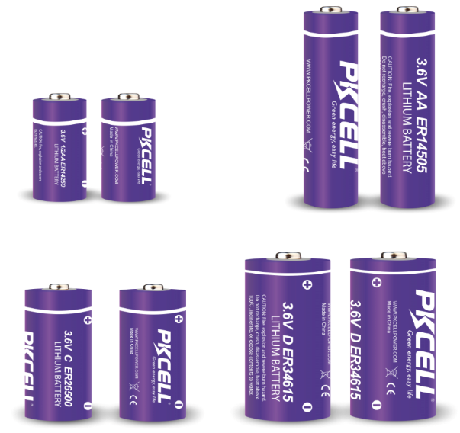
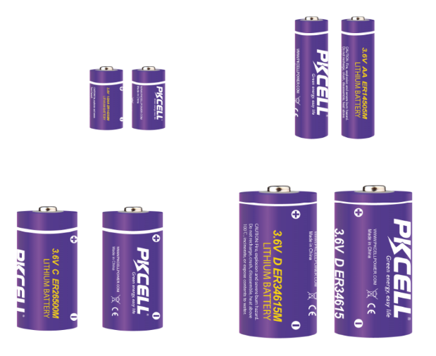
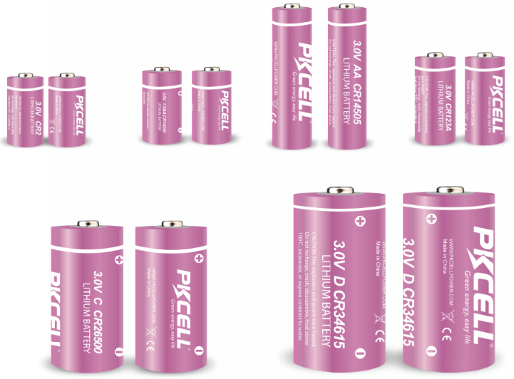
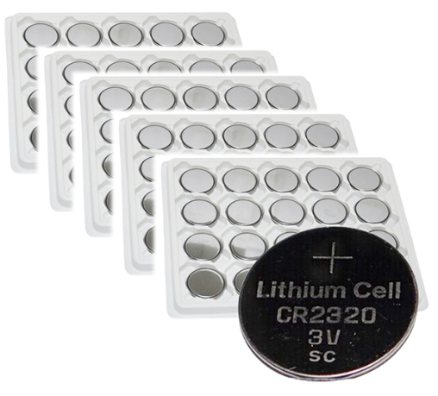
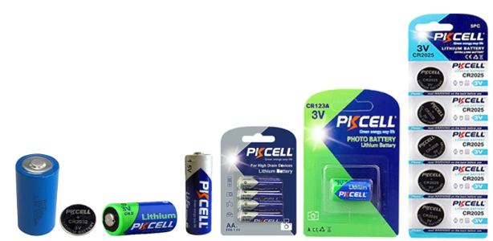
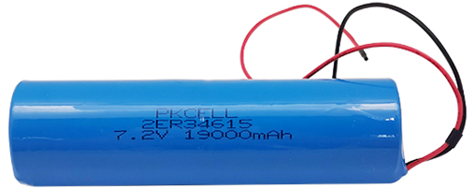
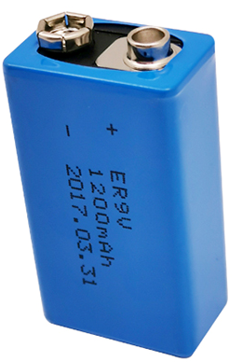
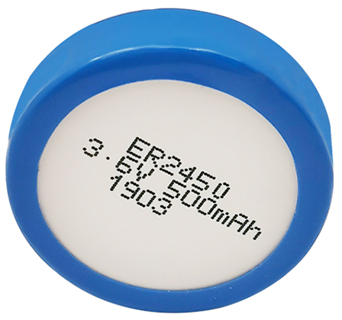
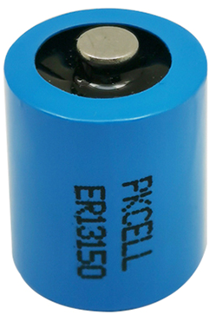
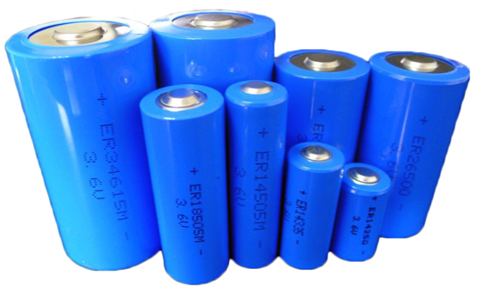
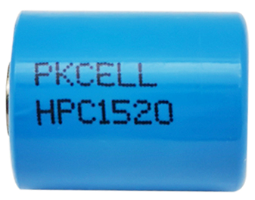
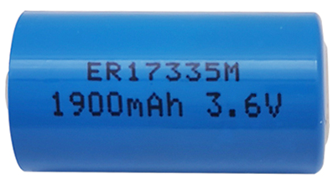
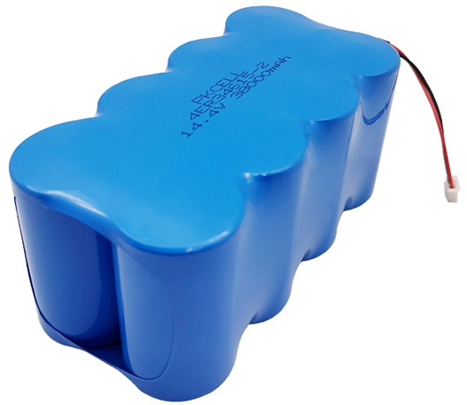
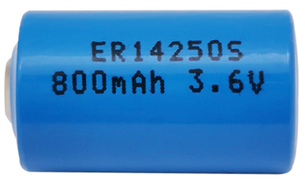
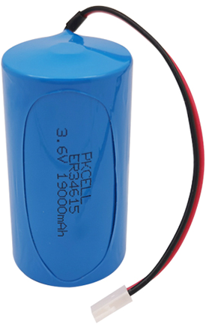
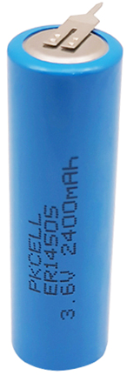
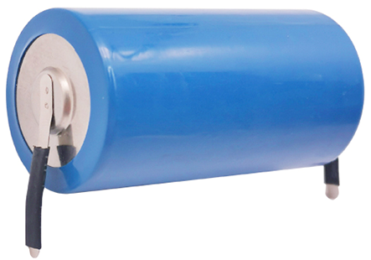
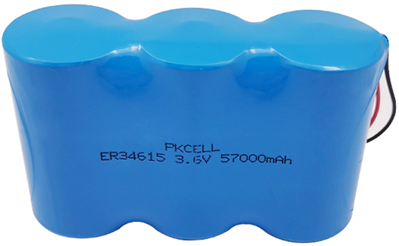
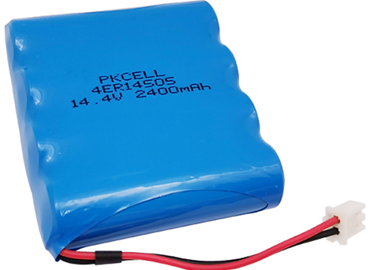
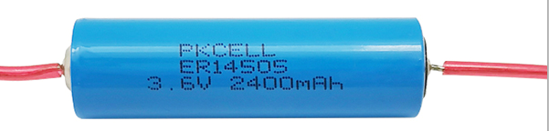
Our products

Slide 14
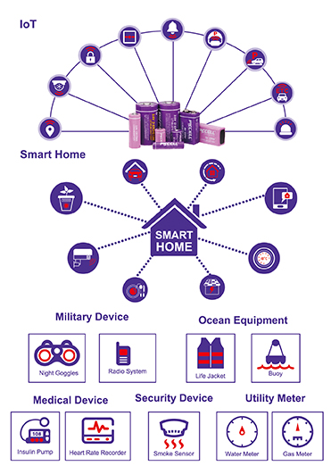
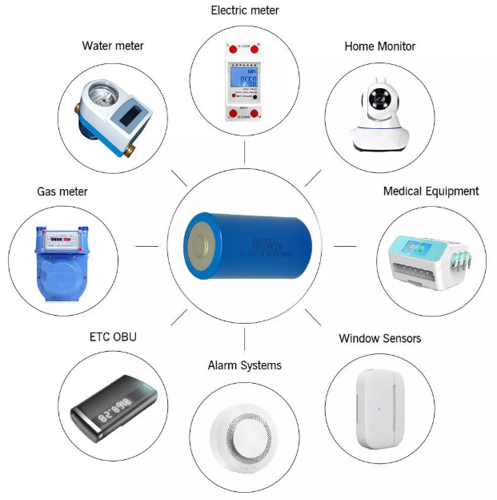

APPLICATION

Slide 15
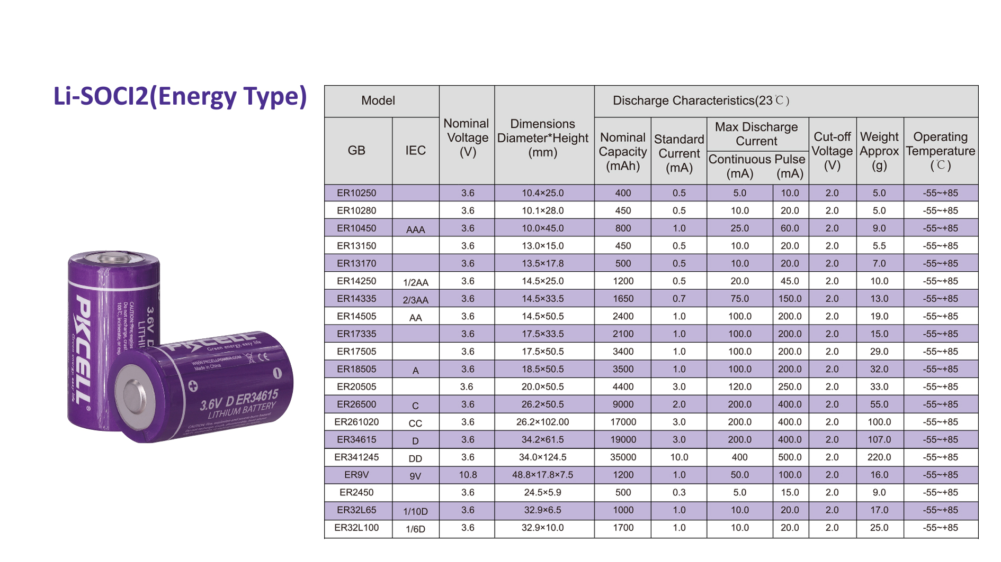

Slide 16
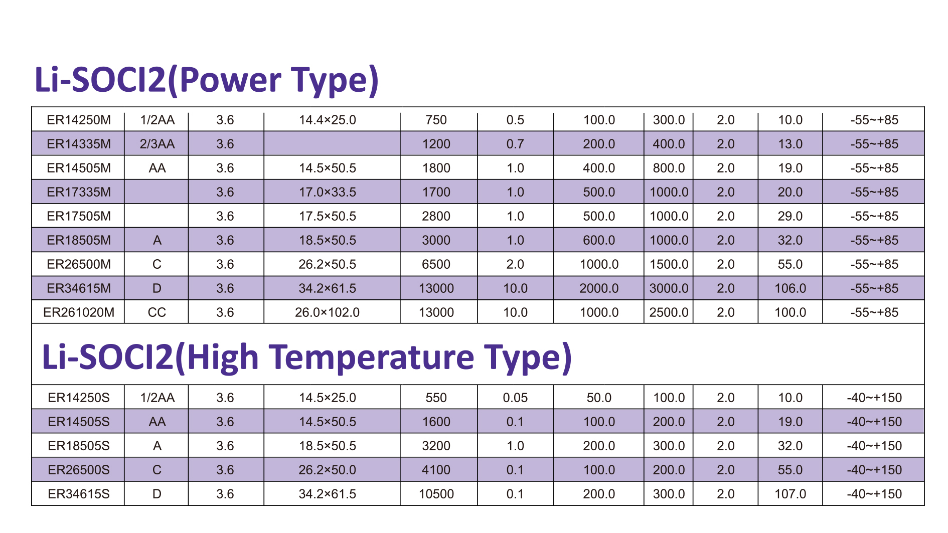

Slide 17
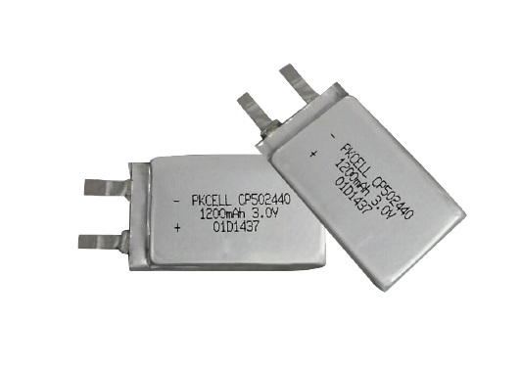
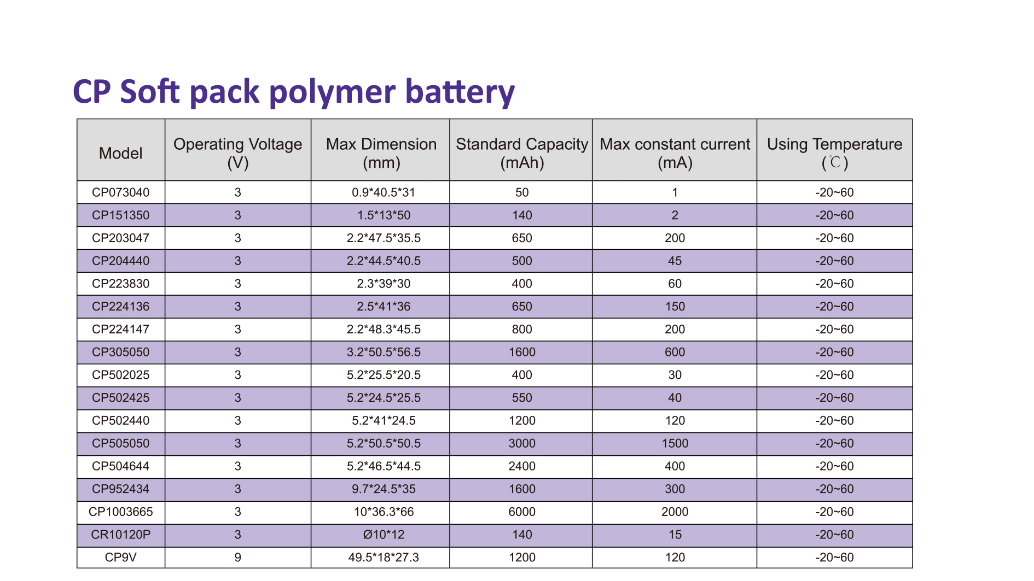

Slide 18
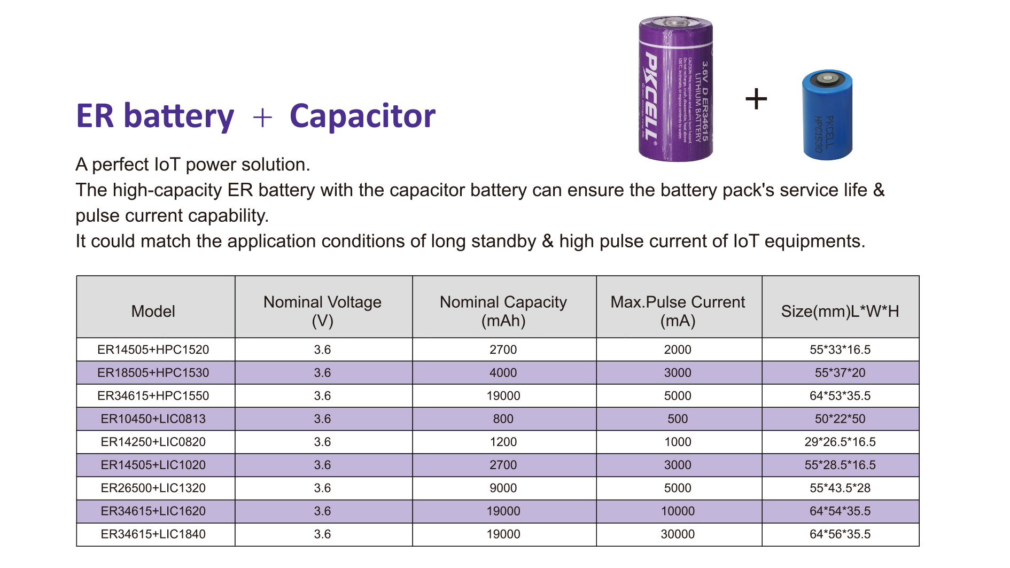
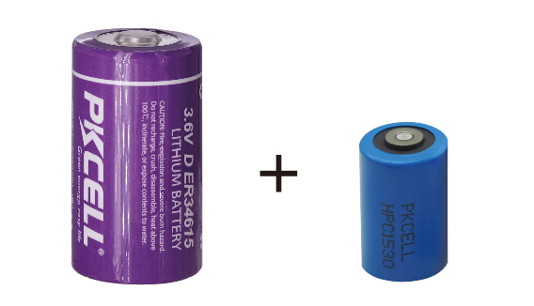

Slide 19
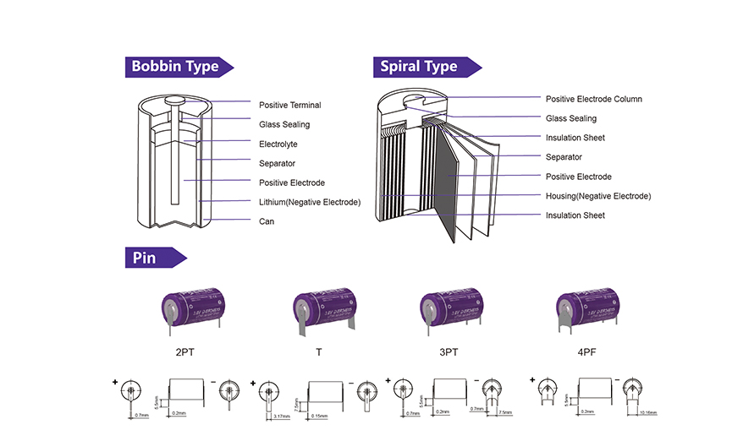

Slide 20
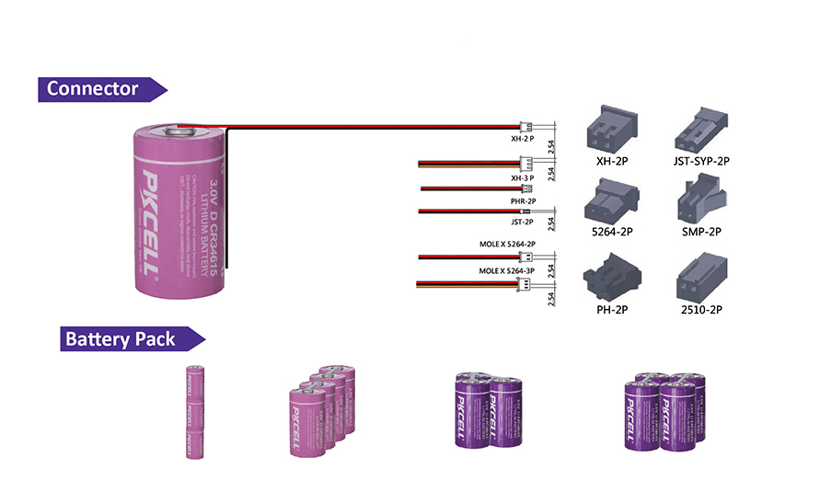

Slide 21
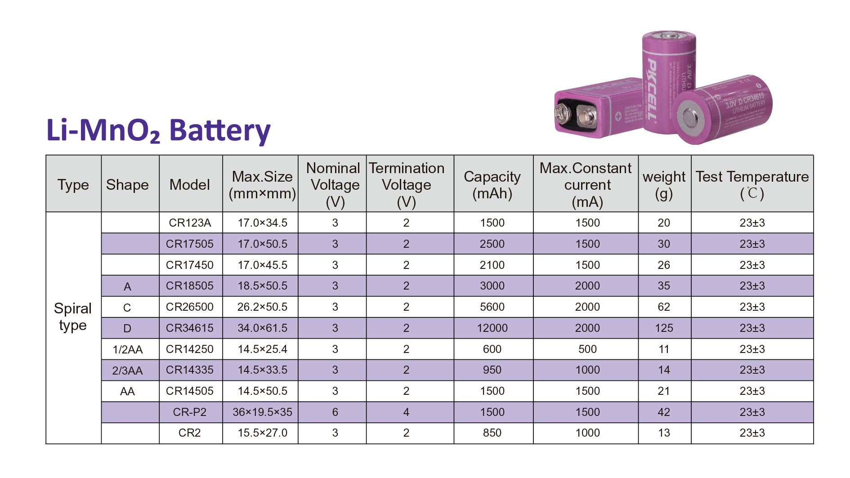

Slide 22
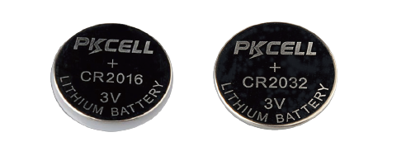
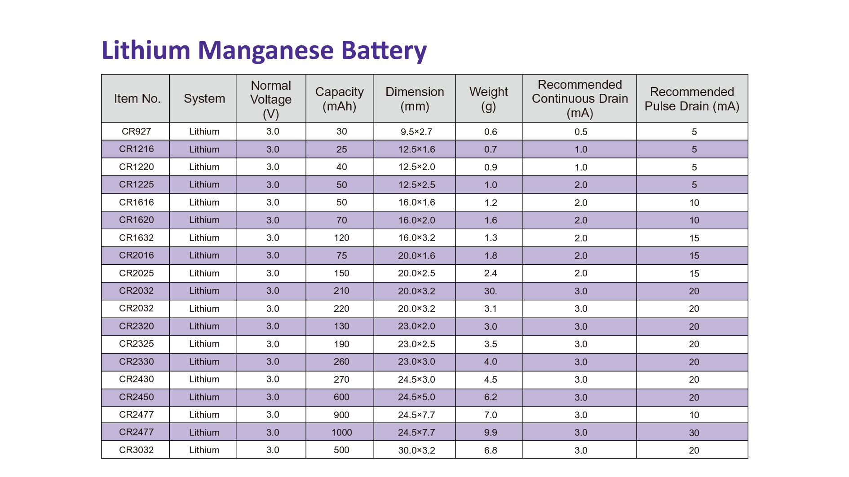

Slide 23
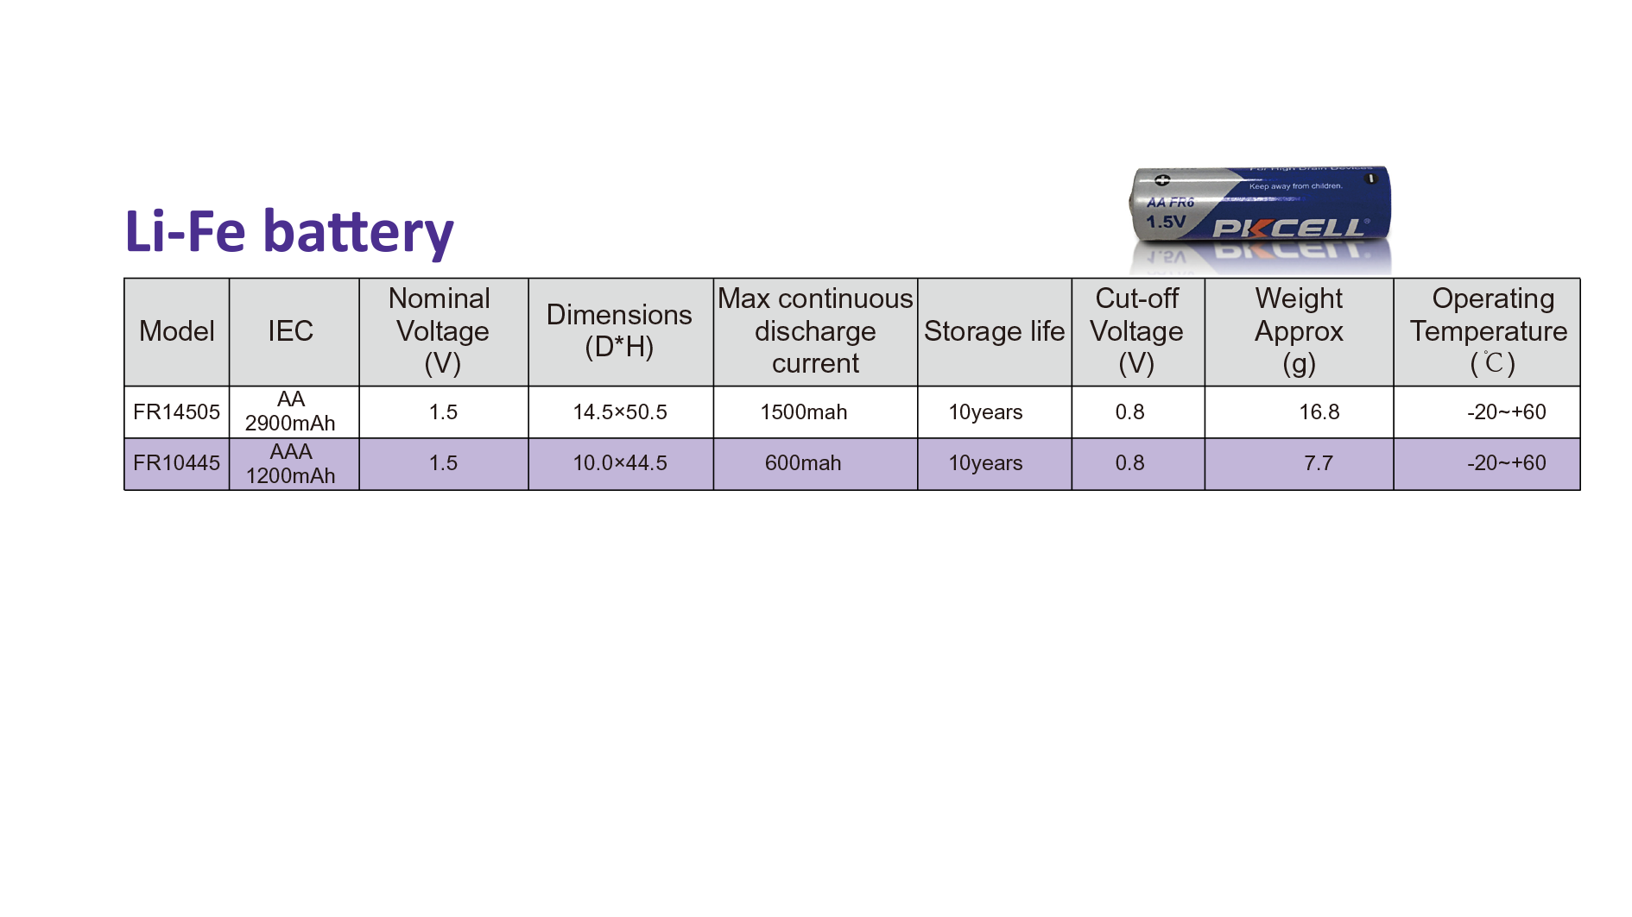

Slide 24
Facility & Certifications
4.

Slide 25
Facility
20000 Square Meter
16000 Square Meter
500 Square Meter
63500 CBM Per Hour
Building Area
Production Area
Testing Center
Drying system capacity

Slide 26
Facility
54 Million Cells Mixed Model
33000
Square meter
120000
Square meter
750 Employees
Production capacity
Current land area
Future land area
Human resources

Slide 27
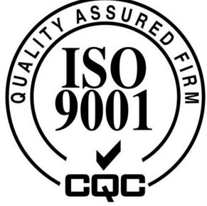












Certifications
ISO 9001
SGS
UL
BV approved
ISO 14001
MSDS
CE
TUV approved
ISO 18001
1.2m drop test
IEC 60086
Alibaba approved
RoHS
Safe transport of goods
UN38.3

Slide 28
Partners
5.

Slide 29


















Partners

Slide 30
Production Lines
6.

Slide 31

Our factory overview

Slide 32
Production Process
Carbon
Mixing
Carbon
Shaping
Carbon Fibrillation
Carbon Cutting and Weighing
Anode Pole Welding
Ultrasonic
Cleaning
Separator
Preparation
Electrolyte Preparation
Battery Assemble
Battery Welding
Electrolyte Injection
Press Seal Nail
Coating Epoxy
Voltage Test
Appearance and
Terminal check
Label and Wrap

Slide 33




Production
The Denmark Technology
Dehumidifying System
Vacuum Drying Oven
Assemble lines
Chemical Balancing System

Slide 34




Automatic Anode
Installation
Automatic Separator
Installation
Automatic Cap Installation
Automatic Nickel Tab
Installation

Slide 35




Environmental
Test Chambers
Shock Test Table
Vibration Test Table
Capacity Test System

Slide 36




Vacuum Mixer
Coating System-1
Coating System-2
Coating System-3

Slide 37






Vacuum Dryer
Battery Welding Machine
Plate Lug Preparation
Rolling Machine
Battery Formation System

Slide 38





Cathode Lug Welding
Battery Cap Seal Machine
Rolling Machine
Electrolyte Injection Machine
Anode Lug Welding

Slide 39




Adding solder tags
Testing
short
circuit
Wraping
PVC

Slide 40


Thanks!
SHENZHEN PKCELL BATTERY CO.,LTD.
WWW.PKCELLPOWER.COM

