Slide 1


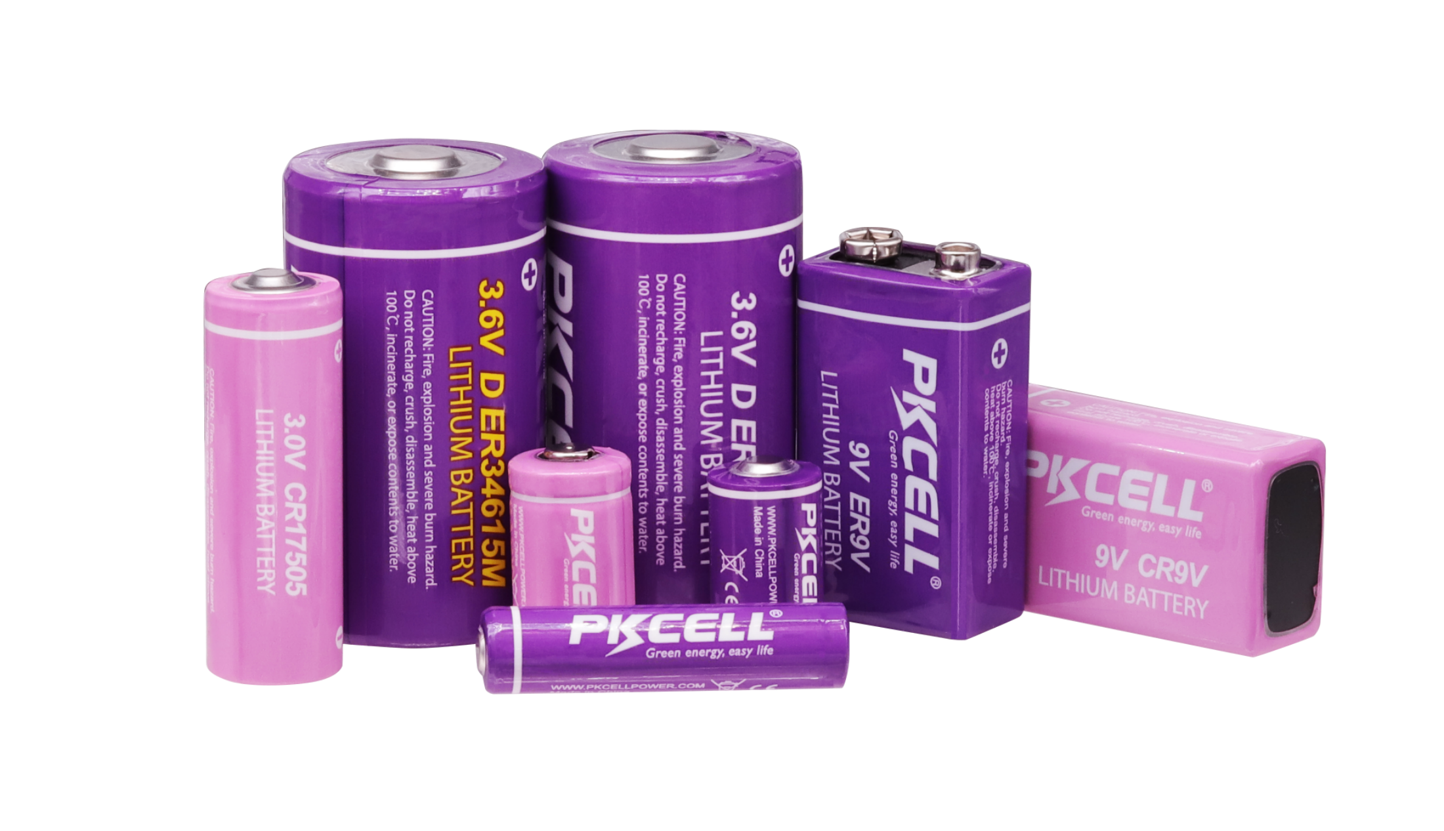
www.pkcellpower.com
Shenzhen PKCELL Battery CO., LTD

Slide 2
CONTENTS
1.
Introduction
4.
Why Choose Us
2.
Products
5.
Production Lines
3.
Application
6.

Slide 3
Introduction
1.
5.

Slide 4
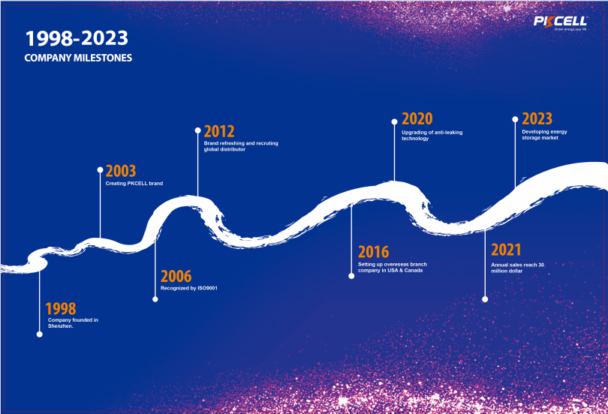

Slide 5
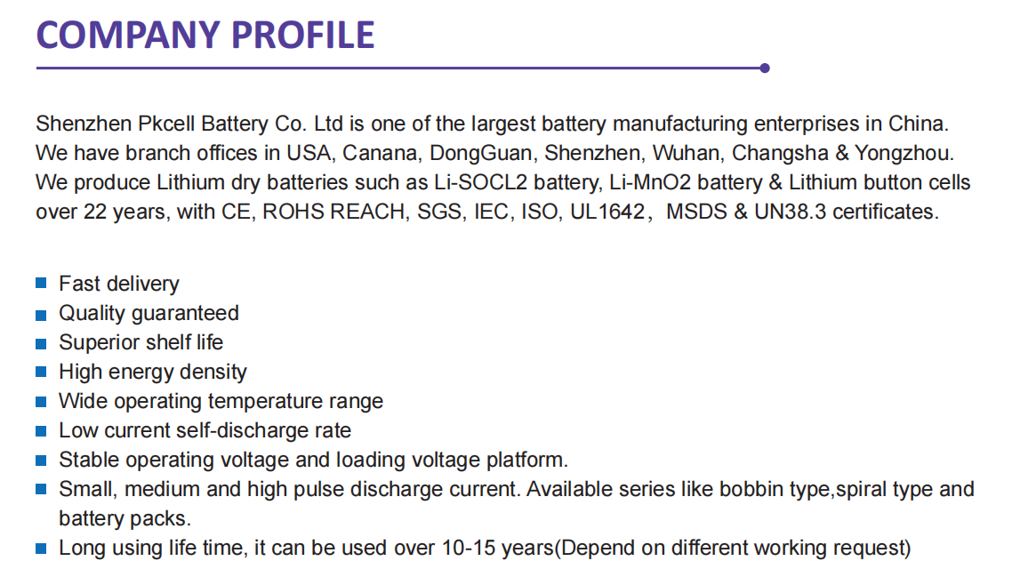

Slide 6
PKCELL is a professional battery manufacturer in China since 1998, with over 25 years of experience in the field of batteries, very popular all over the world. We can produce Li-SOCL2 battery, LiMnO2 battery, Li-Fe battery,super capacitor,customized battery back and so on. For Li-SOCL2 battery,our hot selling models are ER14250,ER14505, ER26500,ER34615,widely used in utility meters like water meters, gas meters, electric meters, and IOT projects and so on. For LiMnO2 battery,our hot Selling models are CR2,CR123A,CR34615, CR2032,CR2025,CR2016,widely used in medical equipment, military equipment,GPS locator and so on. Our batteries are low MOQ, competitive price, 5-10 years shelf life,high quality with CE, ROHS, REACH, SGS，IEC,UL1642, MSDS&UN38.3 certificates.
PKCELL must be your good and reliable battery suppliers.
PKCELL and OEM are acceptable. Welcome to contact us.

Slide 7
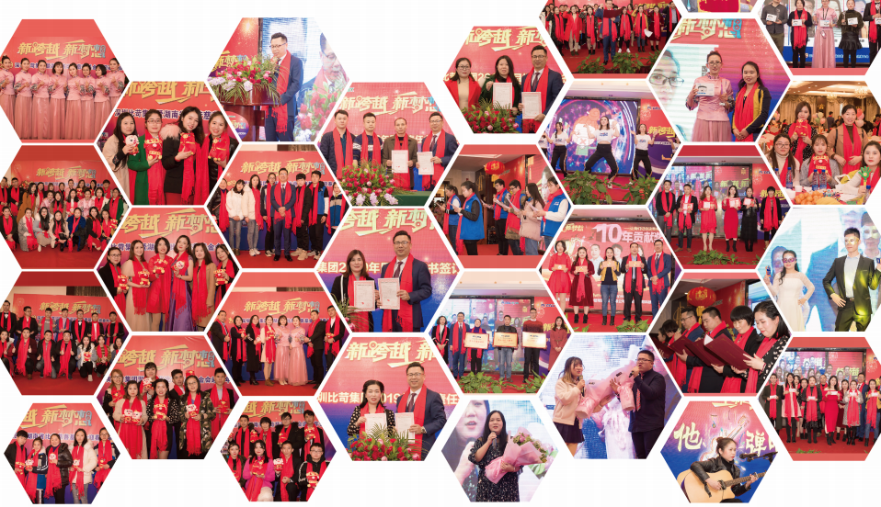
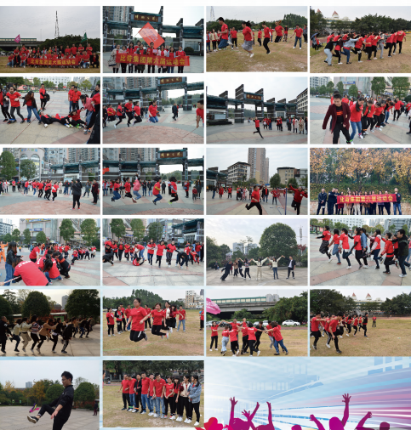
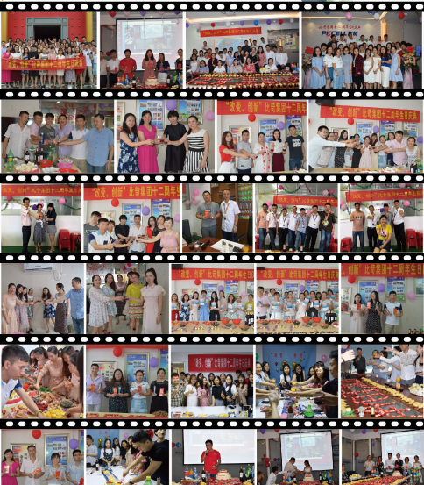
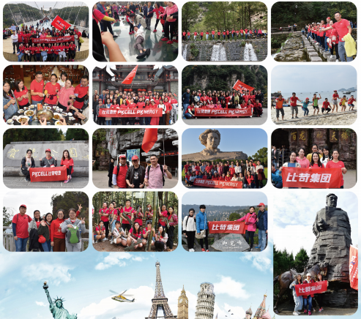
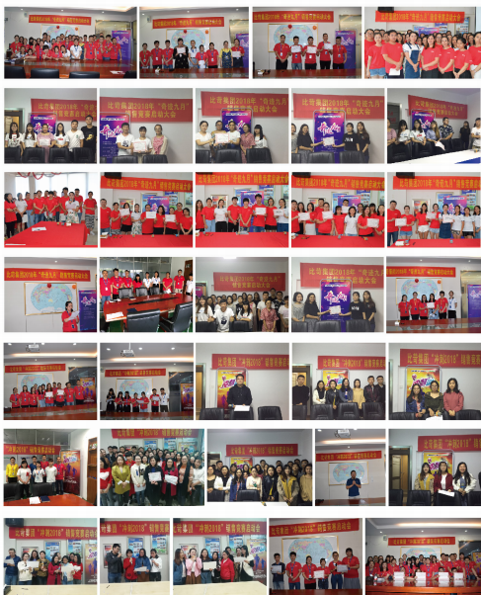
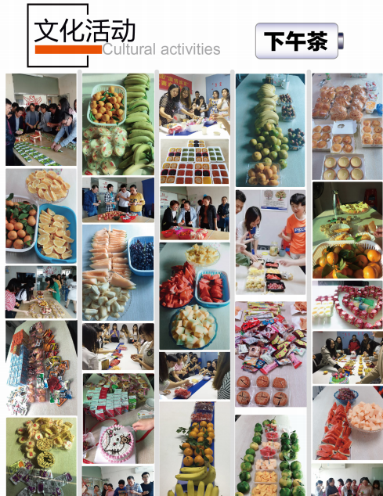
Life in PKCELL

Slide 8
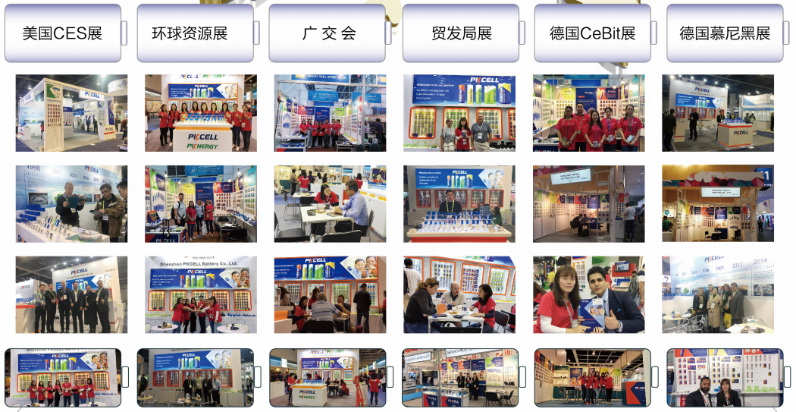

Slide 9

Development
PKCELL Group
Yongzhou
(Branch)
Durengy in CA
(sub company)
Fuspower in US
(sub company)
Changsha
(Branch)
Shenzhen(HQ)
Year of
1998
Year of
2006
Year of
2014
Year of
2016
Year of
2017
1992: Primary Lithium Battery R&D Started
1988: Primary Lithium Battery Production Started
1998: Shenzhen PKCELL battery Co., Ltd established
2002: ISO9001:2000 Certified
2010: ISO14001 and ISO18000 Certified
2019: CE certified

Slide 10
Products
2.

Slide 11
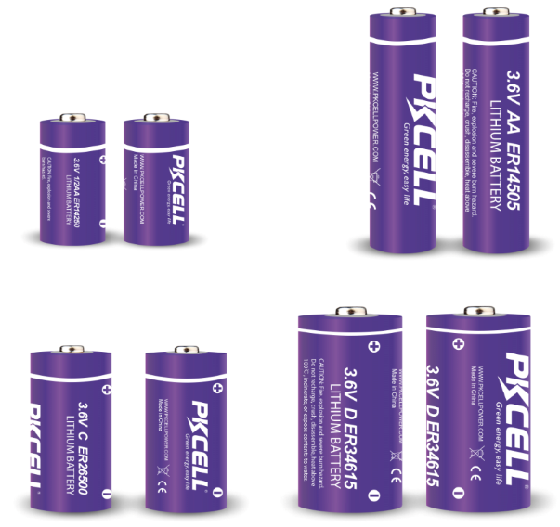
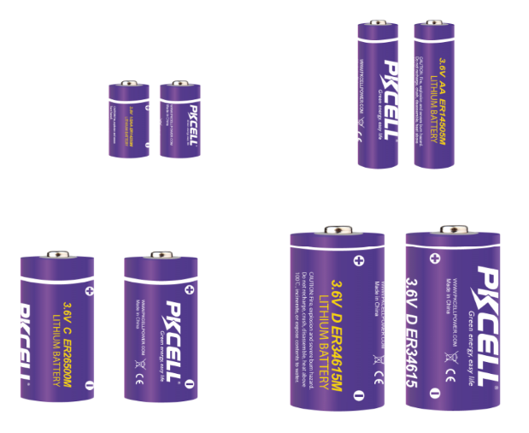
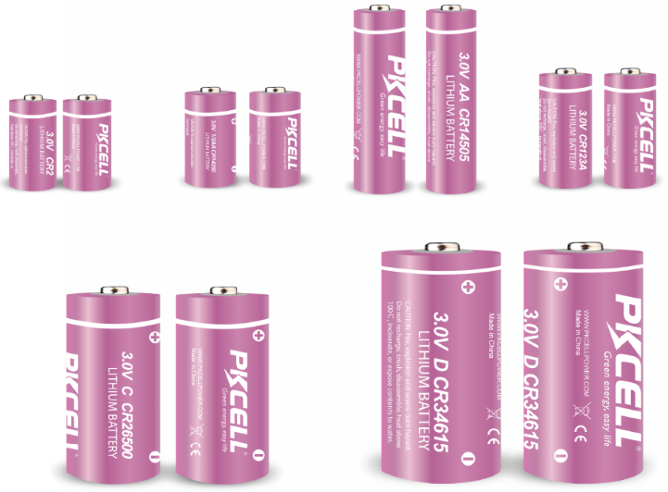
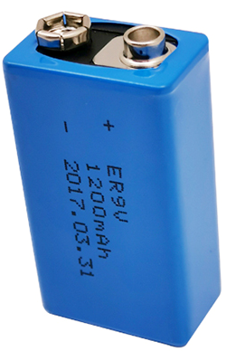
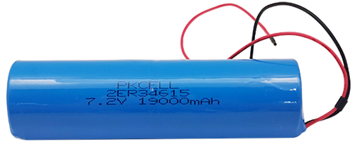
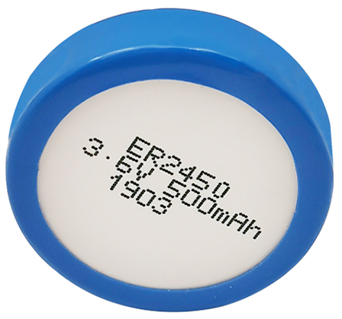
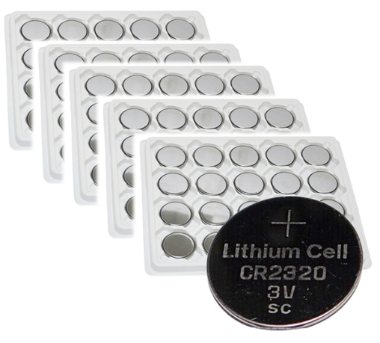
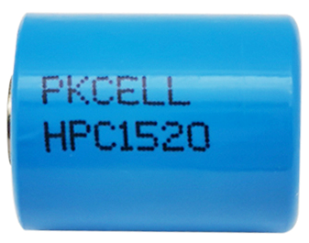
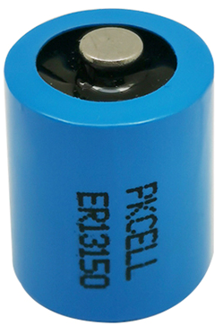
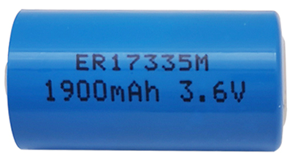
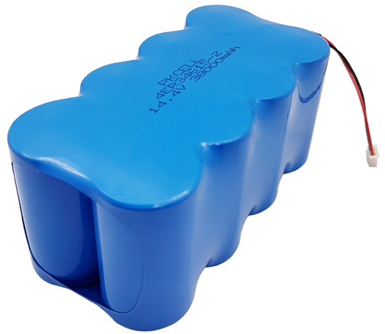
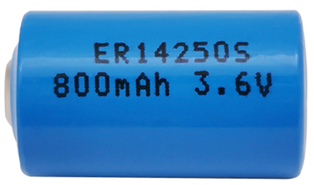
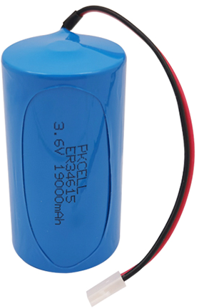
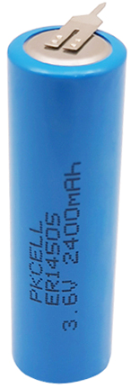
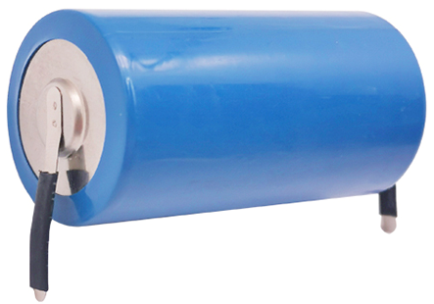
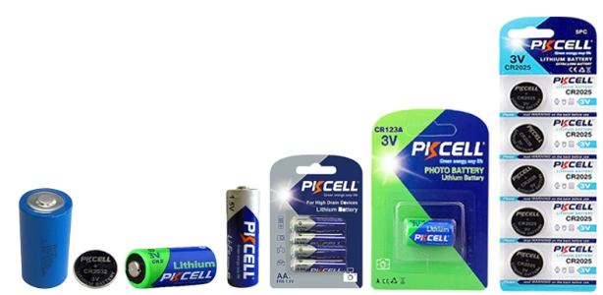
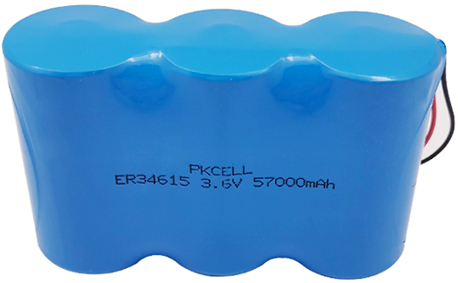
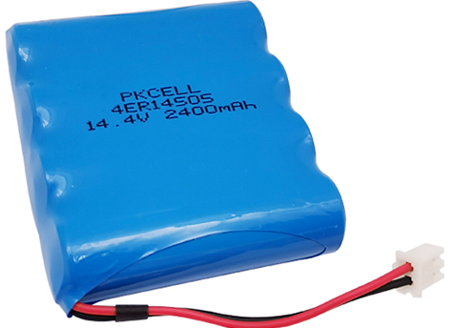
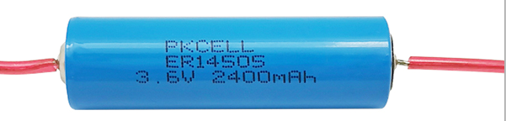

Slide 12
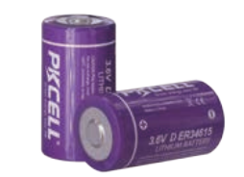

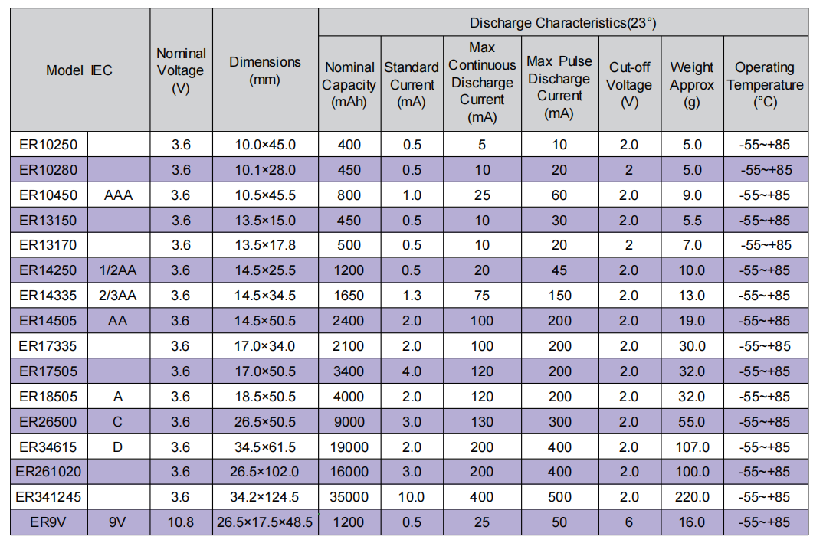

Slide 13
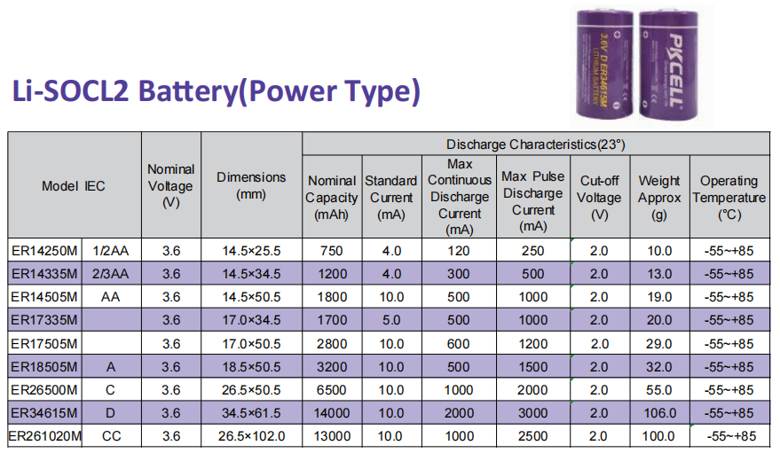

Slide 14
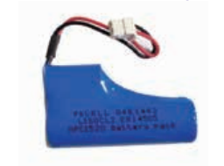

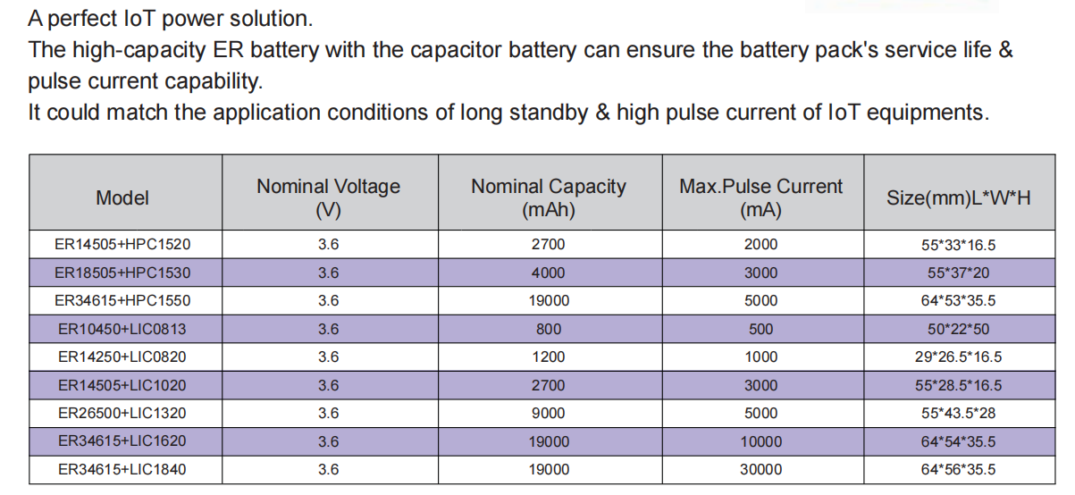

Slide 15
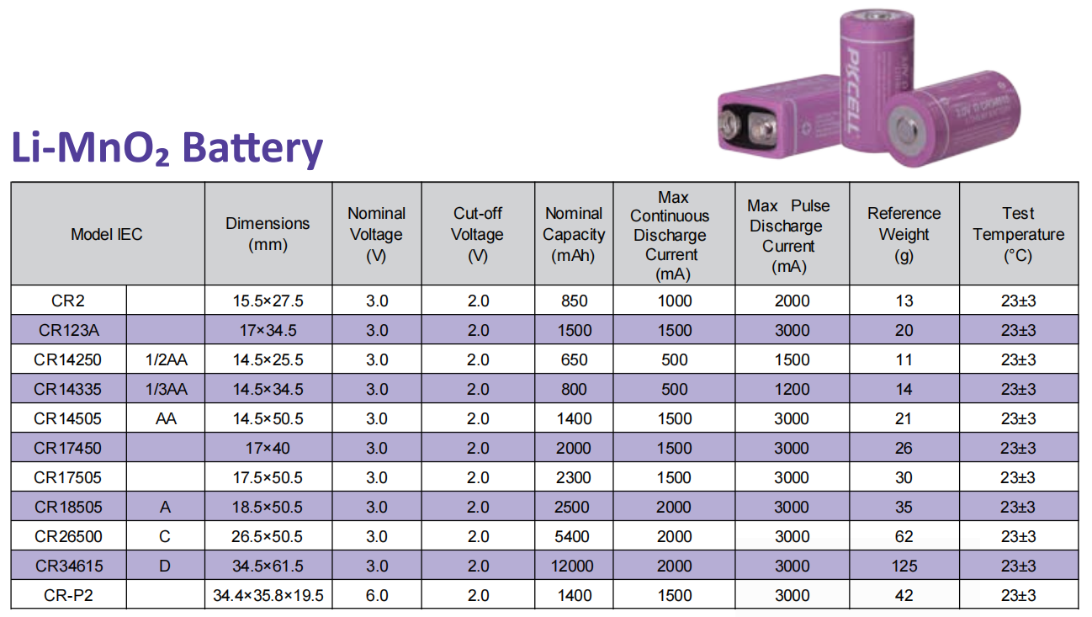

Slide 16
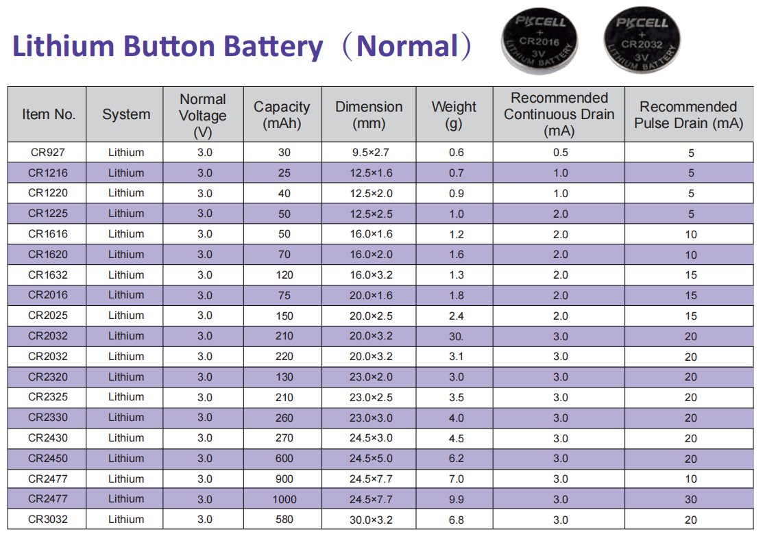

Slide 17
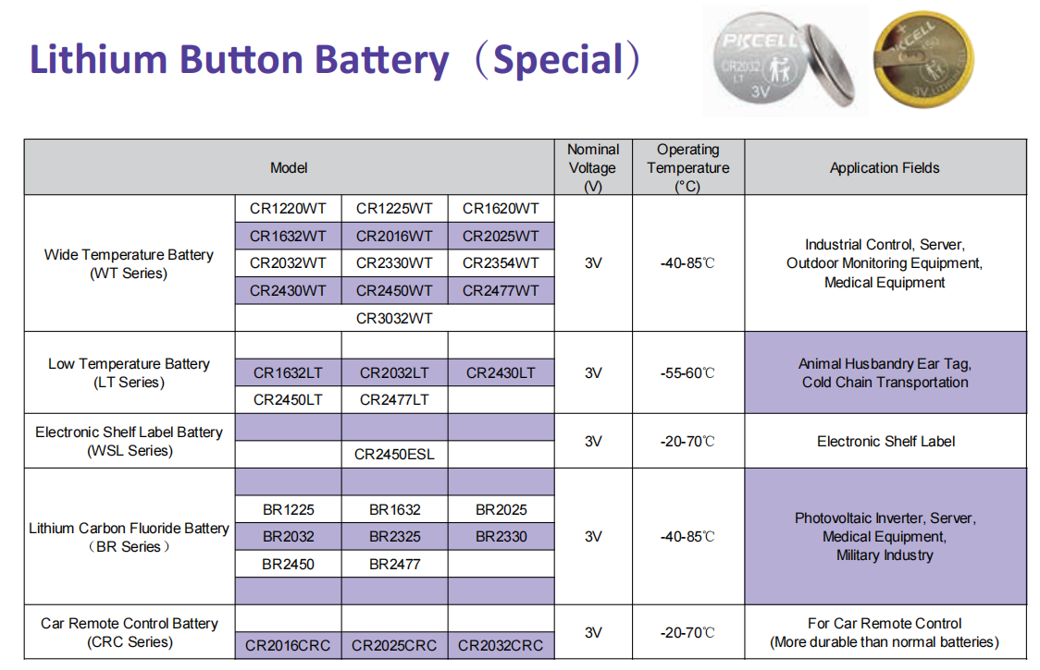

Slide 18
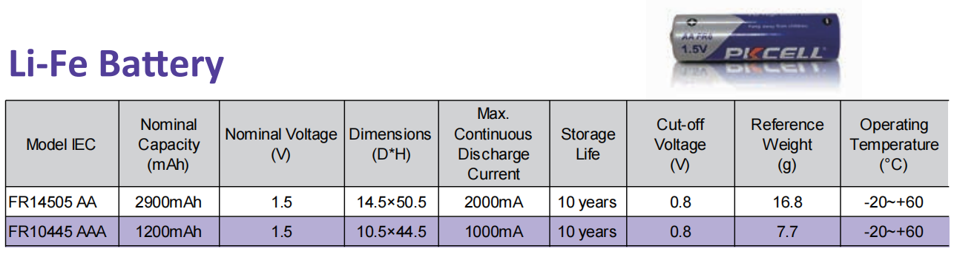

Slide 19
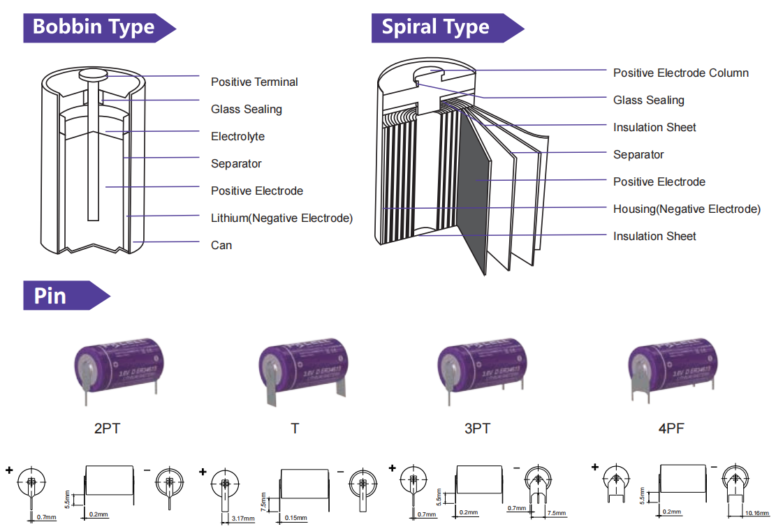

Slide 20
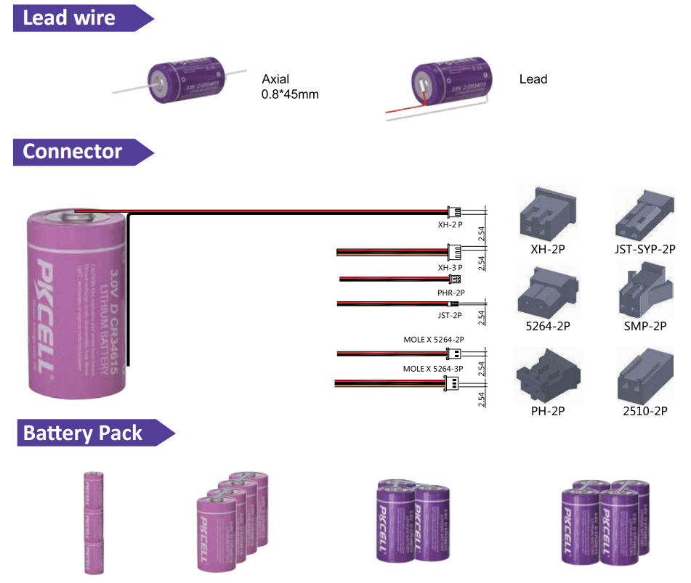

Slide 21
Application
3.

Slide 22
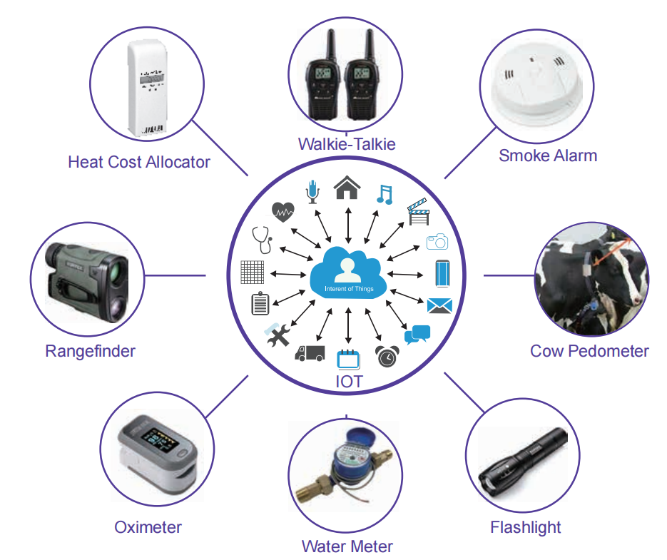
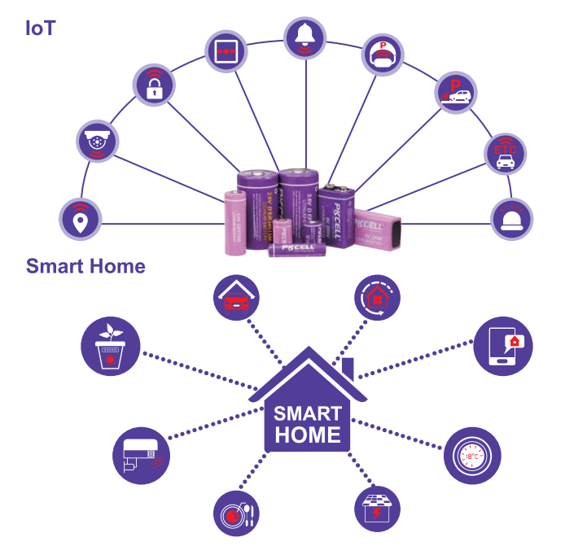
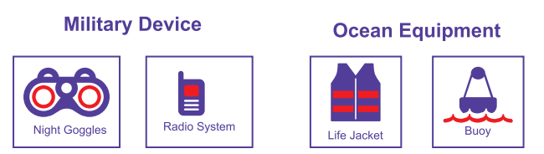
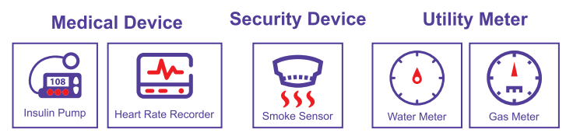
APPLICATION

Slide 23
Why Choose Us
4.

Slide 24
Why choose PKCELL?
1) 25 years experiences in LTC Production
2) Concentration on LTC Cells. 95% Revenues Generated by LTC.
3)Experienced Engineers
4)21 years experience of Exportation and Serving big clients like Walmart, JCB, Honeywell, Philip, etc.
5) Complete certifications: ISO, REACH, CE, SGS, IEC, MSDS, UN38.3, Safe Transport of goods, etc
6) PKCELL is international group company, providing strong backup.
7) Flexible payment terms
8) OEM & ODM service available.

Slide 25
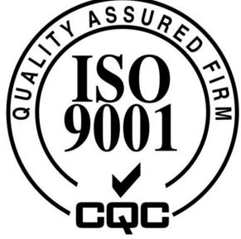




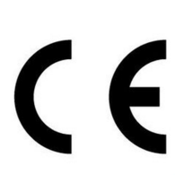


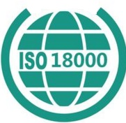


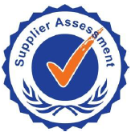

Certifications
ISO 9001
SGS
UL
BV approved
ISO 14001
MSDS
CE
TUV approved
ISO 18001
1.2m drop test
IEC 60086
Alibaba approved
RoHS
Safe transport of goods
UN38.3

Slide 26


















Partners

Slide 27
Production Line
5.

Slide 28
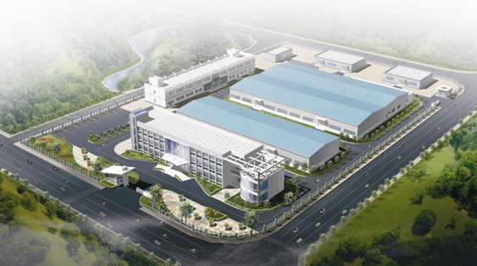
Our factory overview

Slide 29
Production Process
Carbon
Mixing
Carbon
Shaping
Carbon Fibrillation
Carbon Cutting and Weighing
Anode Pole Welding
Ultrasonic
Cleaning
Separator
Preparation
Electrolyte Preparation
Battery Assemble
Battery Welding
Electrolyte Injection
Press Seal Nail
Coating Epoxy
Voltage Test
Appearance and
Terminal check
Label and Wrap

Slide 30
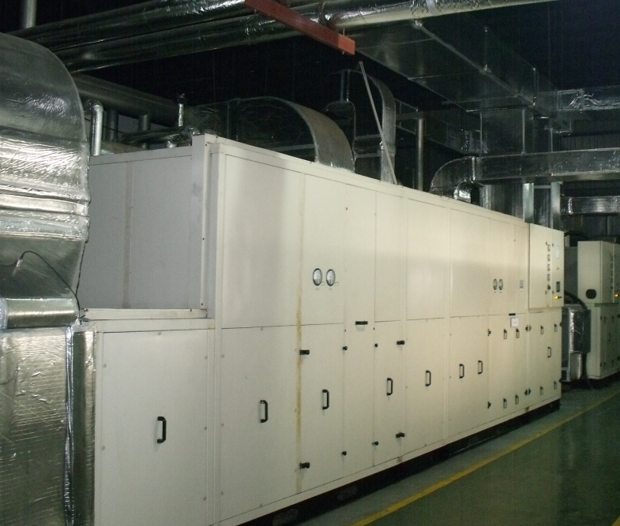



Production
The Denmark Technology
Dehumidifying System
Vacuum Drying Oven
Assemble lines
Chemical Balancing System

Slide 31




Automatic Anode
Installation
Automatic Separator
Installation
Automatic Cap Installation
Automatic Nickel Tab
Installation

Slide 32




Environmental
Test Chambers
Shock Test Table
Vibration Test Table
Capacity Test System

Slide 33




Vacuum Mixer
Coating System-1
Coating System-2
Coating System-3

Slide 34






Vacuum Dryer
Battery Welding Machine
Plate Lug Preparation
Rolling Machine
Battery Formation System

Slide 35





Cathode Lug Welding
Battery Cap Seal Machine
Rolling Machine
Electrolyte Injection Machine
Anode Lug Welding

Slide 36




Adding solder tags
Testing
short
circuit
Wraping
PVC

Slide 37


Thanks!
深圳市比苛电池有限有公司
www.pkcellpower.com

